Slide 1
Adding Fractions
Miss L
Year 7

Slide 2
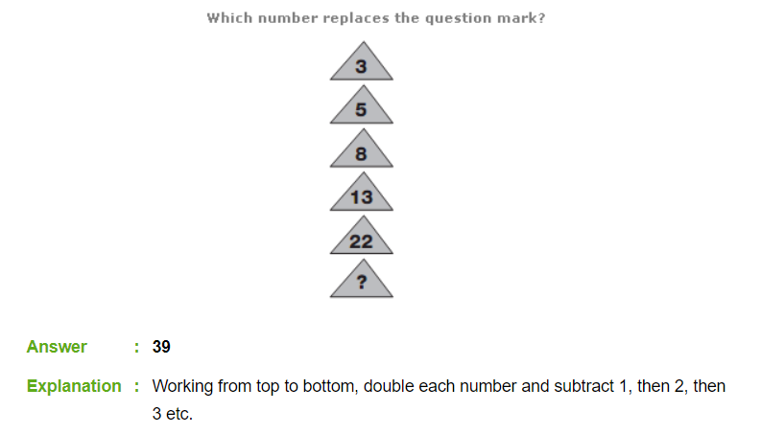

Slide 3
Mixed Fractions

Slide 4
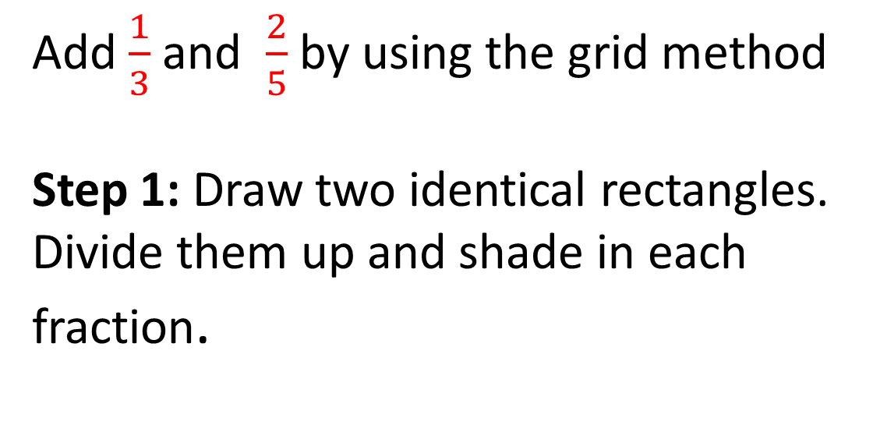
24
7
30
Adding Fractions
Date
EQ – What are the different methods for adding fractions?
Add $\frac{1}{3}$ and $\frac{2}{5}$ by using the grid method
Step 1: Draw two identical rectangles. Divide them up and shade in each fraction.
Method 1
Grids

Slide 5
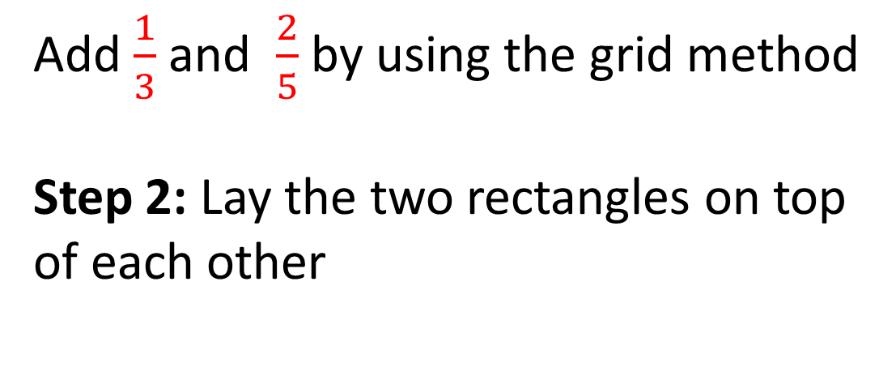
24
7
30
Adding Fractions
Date
EQ – What are the different methods for adding fractions?
Add $\frac{1}{3}$ and $\frac{2}{5}$ by using the grid method
Step 2: Lay the two rectangles on top of each other
Method 1
Grids

Slide 6
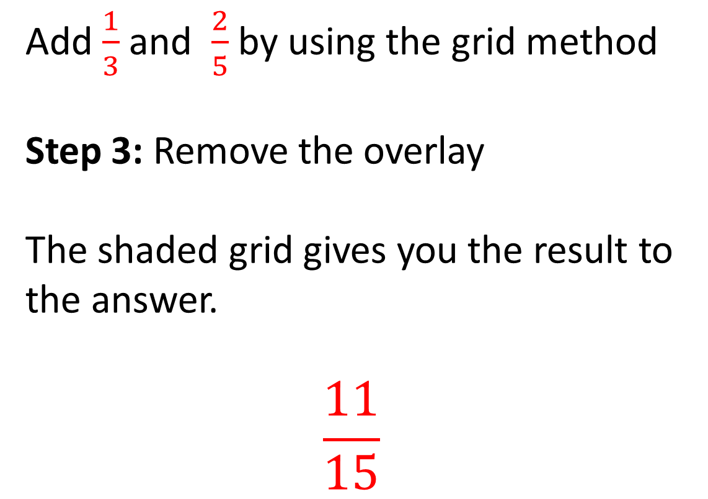
24
7
30
Adding Fractions
Date
EQ – What are the different methods for adding fractions?
Add $\frac{1}{3}$ and $\frac{2}{5}$ by using the grid method
Step 3: Remove the overlay
The shaded grid gives you the result to the answer.
$$\frac{11}{15}$$
Method 1
Grids

Slide 7
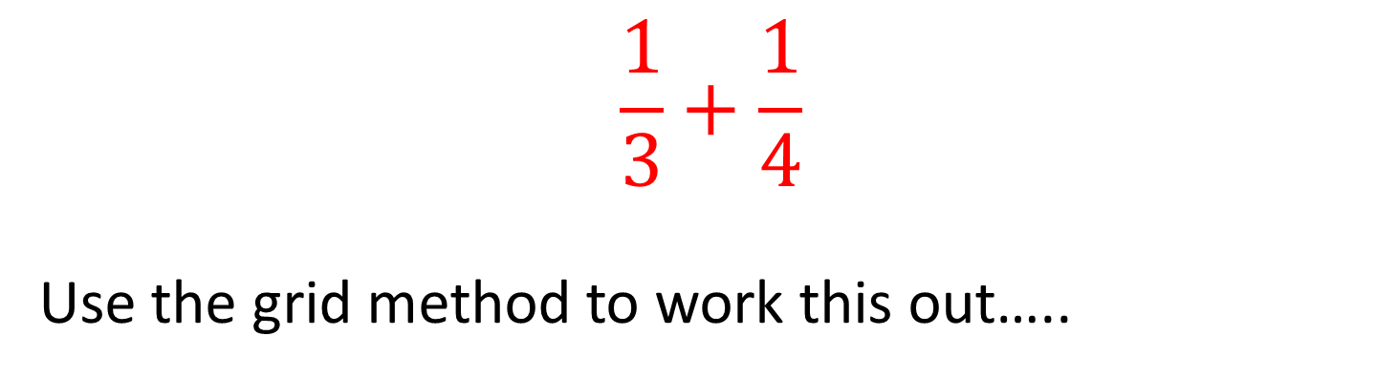
Practice
$$\frac{1}{3}+\frac{1}{4}$$
Use the grid method to work this out…..

Slide 8


Slide 9

24
7
30
Adding Fractions
Date
EQ – What are the different methods for adding fractions?
Method 2
Adding With Same Denominator
$$\frac{1}{7}+\frac{4}{7}$$

Slide 10
24
7
30
Adding Fractions
Date
EQ – What are the different methods for adding fractions?
Method 2
Adding With Same Denominator
$$\frac{1}{7}+\frac{4}{7}$$

Slide 11
24
7
30
Adding Fractions
Date
EQ – What are the different methods for adding fractions?
Method 2
Adding With Same Denominator
$$\frac{1}{7}+\frac{4}{7}$$

Slide 12

24
7
30
Adding Fractions
Date
EQ – What are the different methods for adding fractions?
Method 2
Adding With Same Denominator
$$\frac{1}{7}+\frac{4}{7}=\frac{5}{7}$$

Slide 13
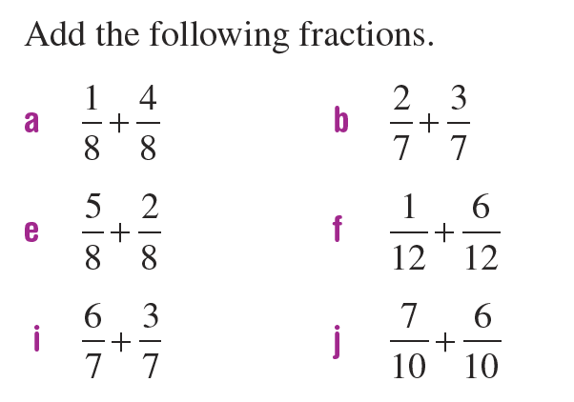
Practice

Slide 14
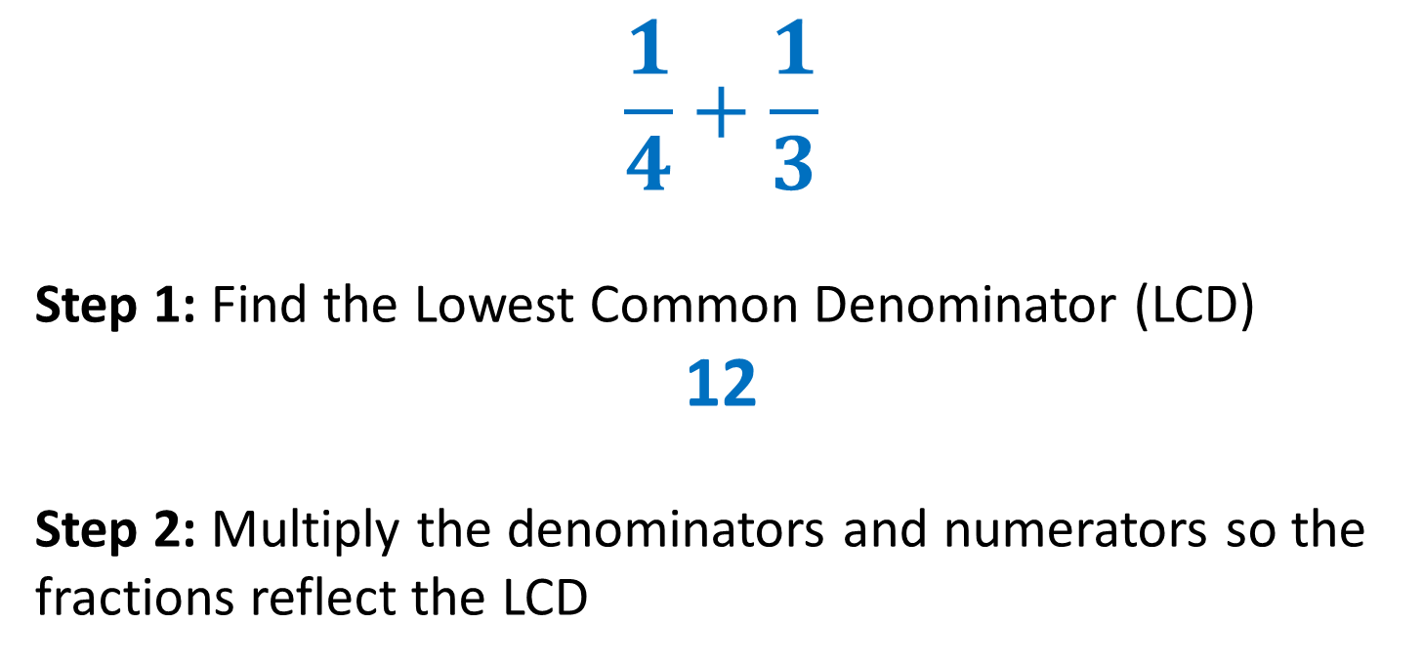
24
7
30
Adding Fractions
Date
EQ – What are the different methods for adding fractions?
Method 3
Finding the Lowest Common Denominator
$$\frac{1}{4}+\frac{1}{3}$$
Step 1: Find the Lowest Common Denominator (LCD)
12
Step 2: Multiply the denominators and numerators so the fractions reflect the LCD

Slide 15
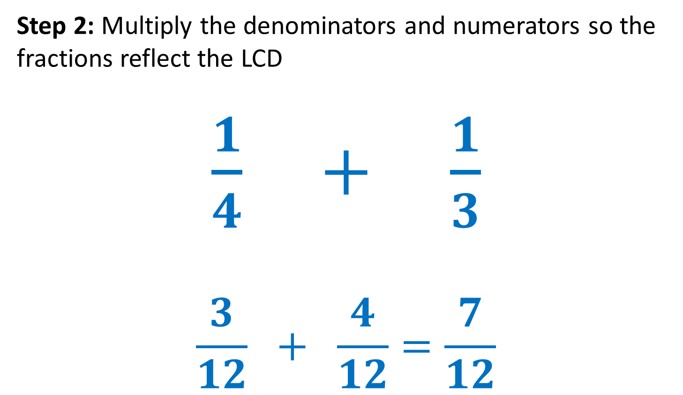
24
7
30
Adding Fractions
Date
EQ – What are the different methods for adding fractions?
Method 3
Finding the Lowest Common Denominator
Step 2: Multiply the denominators and numerators so the fractions reflect the LCD
$\frac{1}{4} + \frac{1}{3}$
$$\frac{3}{12} + \frac{4}{12}=\frac{7}{12}$$

Slide 16
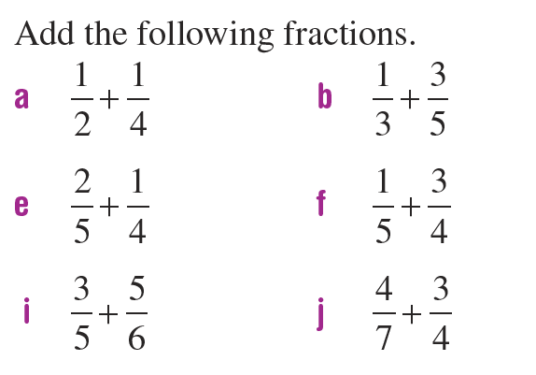
Practice

Slide 17
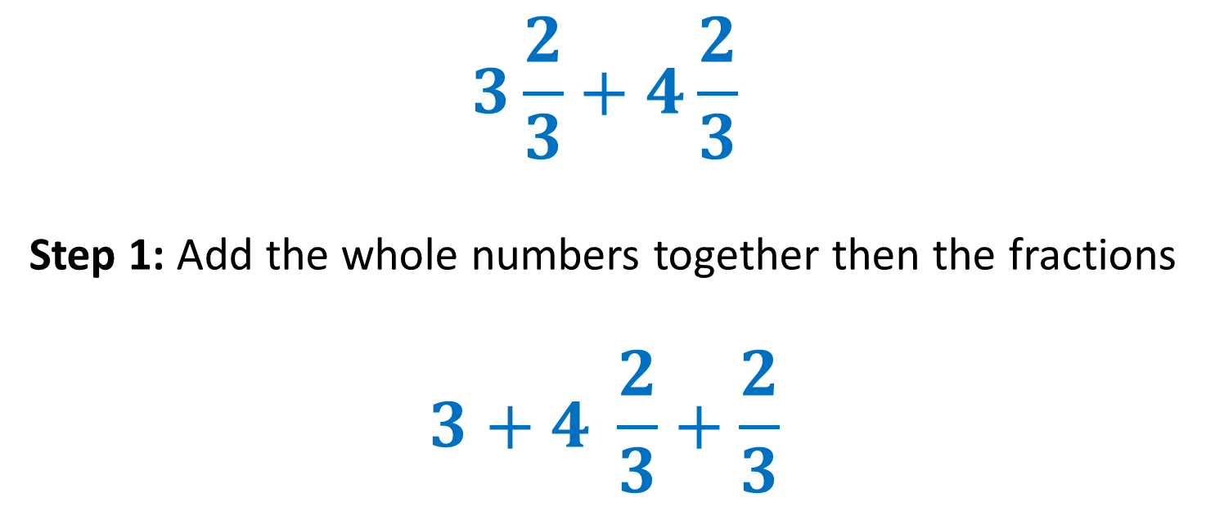
24
7
30
Adding Fractions
Date
EQ – What are the different methods for adding fractions?
Method 4
Mixed Numbers
$$3\frac{2}{3}+4\frac{2}{3}$$
Step 1: Add the whole numbers together then the fractions
$$3+4 \frac{2}{3}+\frac{2}{3}$$

Slide 18

24
7
30
Adding Fractions
Date
EQ – What are the different methods for adding fractions?
Step 2: Simplify the answer.
$$7 + \frac{4}{3}$$
$$\frac{4}{3}=1\frac{1}{3}$$
$$7 +1\frac{1}{3}=8\frac{1}{3}$$
Method 4
Mixed Numbers

Slide 19
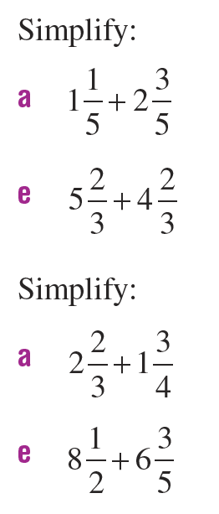
Practice

